Slide 1

Logistic regression
Analysis and insights

Slide 2
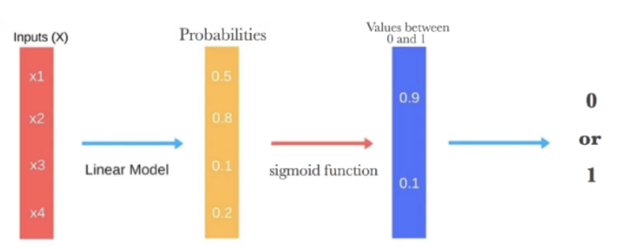

Logistic regression
A simple yet effective tool for classification tasks is the logit model. This model is often used as a baseline/benchmark approach before using more sophisticated machine learning models to evaluate the performance improvements.
The logistic regression takes the output of a linear function of k independent variables and uses the logistic link function to output this value within the range of [0,1]. The logistic function has an "S" shape and takes a set of real values and maps it to a range of 0 to 1, but never exactly at the 0 or 1 values. Thus, the outputs of a logistic regression are probability values and we assign a value of 1 if the probability value is above a threshold value.

Slide 3


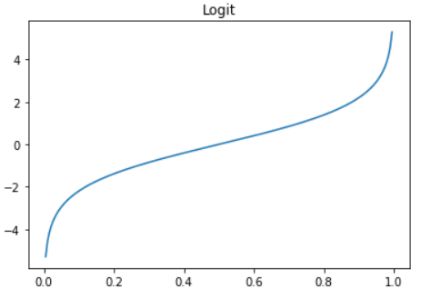
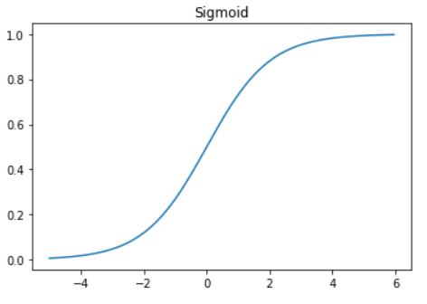
Logit and sigmoid functions
The inverse of the logit function is the sigmoid function. If you have a probability p, Sigmoid(Logit(p))=p. Thus, the sigmoid function maps the real values back to the range of [0,1].
The logit link function is particularly intuitive as it is log of the odds ratio. For example, given a probability p, the odds are calculated as {p}/{1-p} where p=0.8, the odds are 4 to 1 (i.e., 0.8/0.2=4).

Slide 4
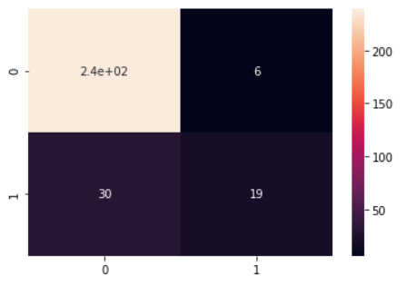

Confusion matrix and accuracy score
We obtain an accuracy of 87.75% using the Logistic Regression model.
From the confusion matrix, we see that:
Type | Count
True Negative | 239
False Positive | 6
False Negative | 30
True Positive | 19

Slide 5
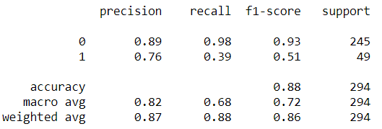
Test set metrics – precision, recall, f1 score
Metric | Attrition = 0 | Attrition = 1
Precision | 0.89 | 0.76
Recall | 0.98 | 0.39
F1-Score | 0.93 | 0.51
Support | 245 | 49

Slide 6
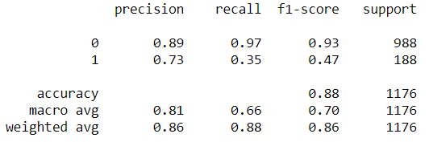
Training set metrics – precision, recall, f1 score
Metric | Attrition = 0 | Attrition = 1
Precision | 0.89 | 0.73
Recall | 0.97 | 0.35
F1-Score | 0.93 | 0.47
Support | 988 | 188

Slide 7
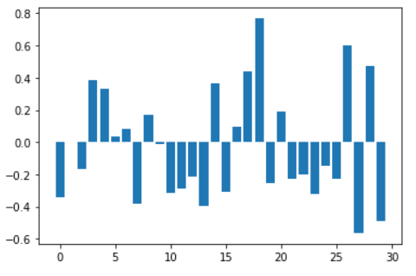
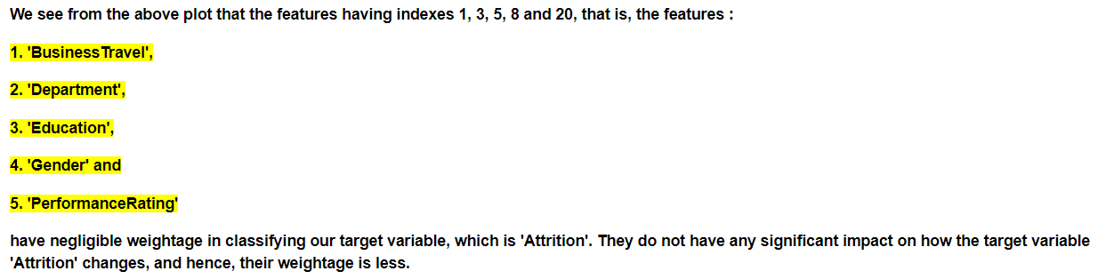
Feature importance analysis

Slide 8
Decision Trees
Decision Trees (DTs) are a non-parametric supervised learning method used for classification and regression. Decision trees learn from data to approximate a sine curve with a set of if-then-else decision rules. The deeper the tree, the more complex the decision rules and the fitter the model.
How Do Decision Trees Work?
Splitting
Pruning
Tree Selection
Key Factors :
Entropy
Information Gain

Slide 9
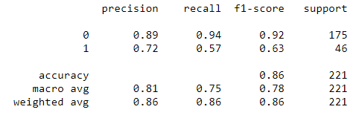

Test set metrics – precision, recall, f1 score
Confusion Matrix
Metric | Attrition = 0 | Attrition = 1
Precision | 0.89 | 0.72
Recall | 0.94 | 0.57
F1-Score | 0.92 | 0.63
Support | 175 | 46

Slide 10
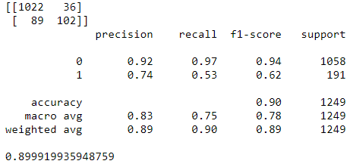
Training set metrics – precision, recall, f1 score
Confusion Matrix
Metric | Attrition = 0 | Attrition = 1
Precision | 0.92 | 0.74
Recall | 0.97 | 0.53
F1-Score | 0.94 | 0.62
Support | 1058 | 191

Slide 11

Random Forest
Random forests or random decision forests are an ensemble learning method for classification, regression and other tasks that operate by constructing a multitude of decision trees at training time and outputting the class that is the mode of the classes (classification) or mean prediction (regression) of the individual trees. Random decision forests correct for decision trees' habit of overfitting to their training set.
Random forest, like its name implies, consists of a large number of individual decision trees that operate as an ensemble. Each individual tree in the random forest spits out a class prediction and the class with the most votes becomes our model’s prediction (see figure below).

Slide 12
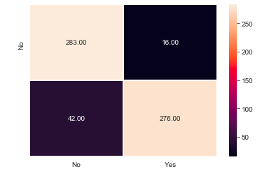

Confusion matrix and accuracy score
We obtain an accuracy of 90.59% (testing data) using the Random Forest model.
From the confusion matrix, we see that:
Type | Count
True Negative | 283
False Positive | 16
False Negative | 42
True Positive | 276

Slide 13
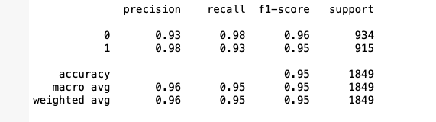
Training set metrics – precision, recall, f1 score, Support
Metric | Attrition = 0 | Attrition = 1
Precision | 0.93 | 0.98
Recall | 0.98 | 0.93
F1-Score | 0.96 | 0.95
Support | 934 | 915

Slide 14
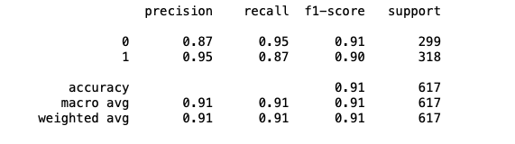
Test set metrics – precision, recall, f1 score, Support
Metric | Attrition = 0 | Attrition = 1
Precision | 0.87 | 0.95
Recall | 0.95 | 0.87
F1-Score | 0.91 | 0.90
Support | 299 | 318

Slide 15

Thank You

